Slide 1
Training Tricks for deep learning (NN) models
Dr. Umarani Jayaraman

Slide 2
Training Tricks (or) Efficient Training in Deep neural networks
Batch Normalization
Overfitting and Under-fitting
Regularization- L1 and L2 regularization
Dropout
Early Stopping
Data Augmentation

Slide 3
Normalization
Typically in machine learning, it is common to normalize input data before passing the data to the input layer.
The reason we normalize is partly to ensure that our model can generalize appropriately.
This is achieved by ensuring that the scale of the values is balanced, and also the range of the values are maintained and proportional despite the scale change in the values.

Slide 4
Normalization
Normalization is typically carried out on the input data, but it would make sense that the flow of internal data within the network should remain normalized.
BN is the internal enforcer of normalization within the input values passed between the layer of a neural network.
Batch normalization limits the covariate shift that usually occurs to the activations within the layers.

Slide 5
Covariate Shift
A variable is a covariate if it is related to the dependent variable
Shifting data is adding a constant k to each member of a data set, where k is real number
It is lifting the entire distribution of data set by distance ‘k’
Covariate shift refers to the change in the distribution of the input variables present in the training and the test data

Slide 6
Batch Normalization
Batch Normalization is a technique that mitigates the effect of unstable gradients within deep neural networks.
BN introduces an additional layer to the neural network that performs operations on the inputs from the previous layer.
The operation standardizes and normalizes the input values.
The input values are then transformed through scaling and shifting operations.

Slide 7
Batch Normalization
Standardization of the inputs data
Normalization and rescaling of the input data
An offset of the input data

Slide 8
Batch Normalization
Standardization is an operation that transforms a batch of input data to have a zero mean and unit variance (standard deviation)
Let’s break down the mathematical notation of the algorithm and explain the process

Slide 9
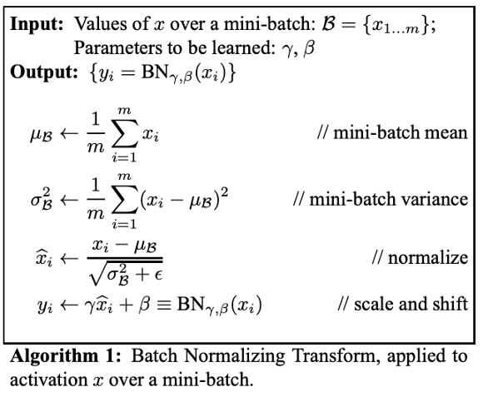
Batch Normalization

Slide 10
Batch Normalization
The components are parameters vectors that are used for the scaling(γ) and shifting(β) of the vector containing values from the previous operations.
The values of the parameter vectors for scaling and shifting are learnable parameters.
During neural network training, BN ensures that the learnable parameters are the optimal values that enable accurate normalization of each mini-batch.

Slide 11
Batch Normalization
Batch normalization was performed as a solution to speed up the training phase of deep neural networks through the introduction of internal normalization of the inputs values within the neural network layer.

Slide 12
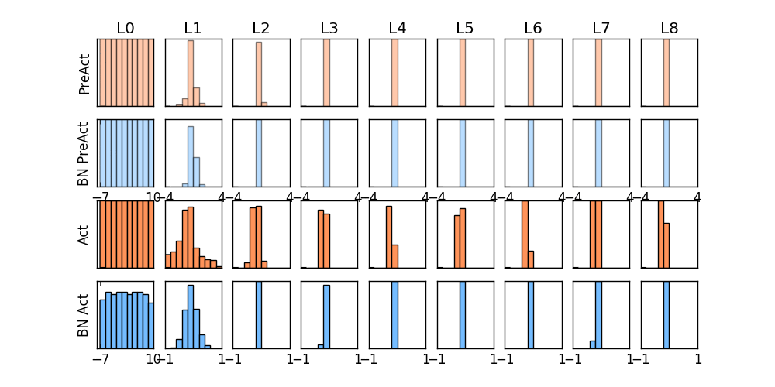
Batch Normalization

Slide 13
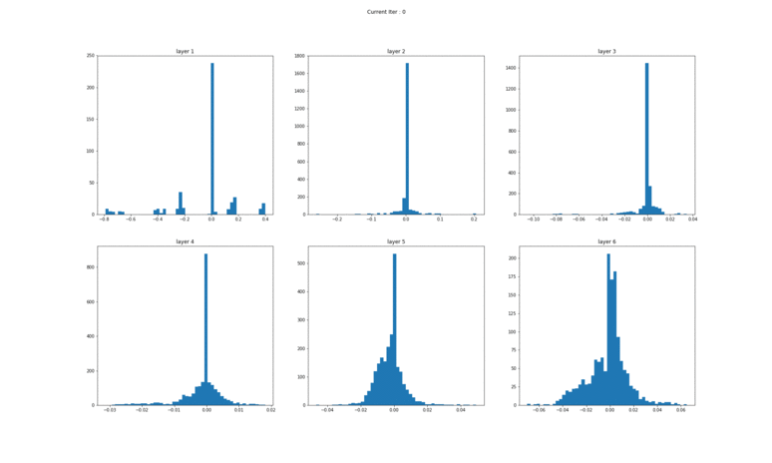
WITHOUT BATCH NORM
Gradients w.r.t. Weights at each layer (layer-1 to layer-6 Top left to bottom right)

Slide 14
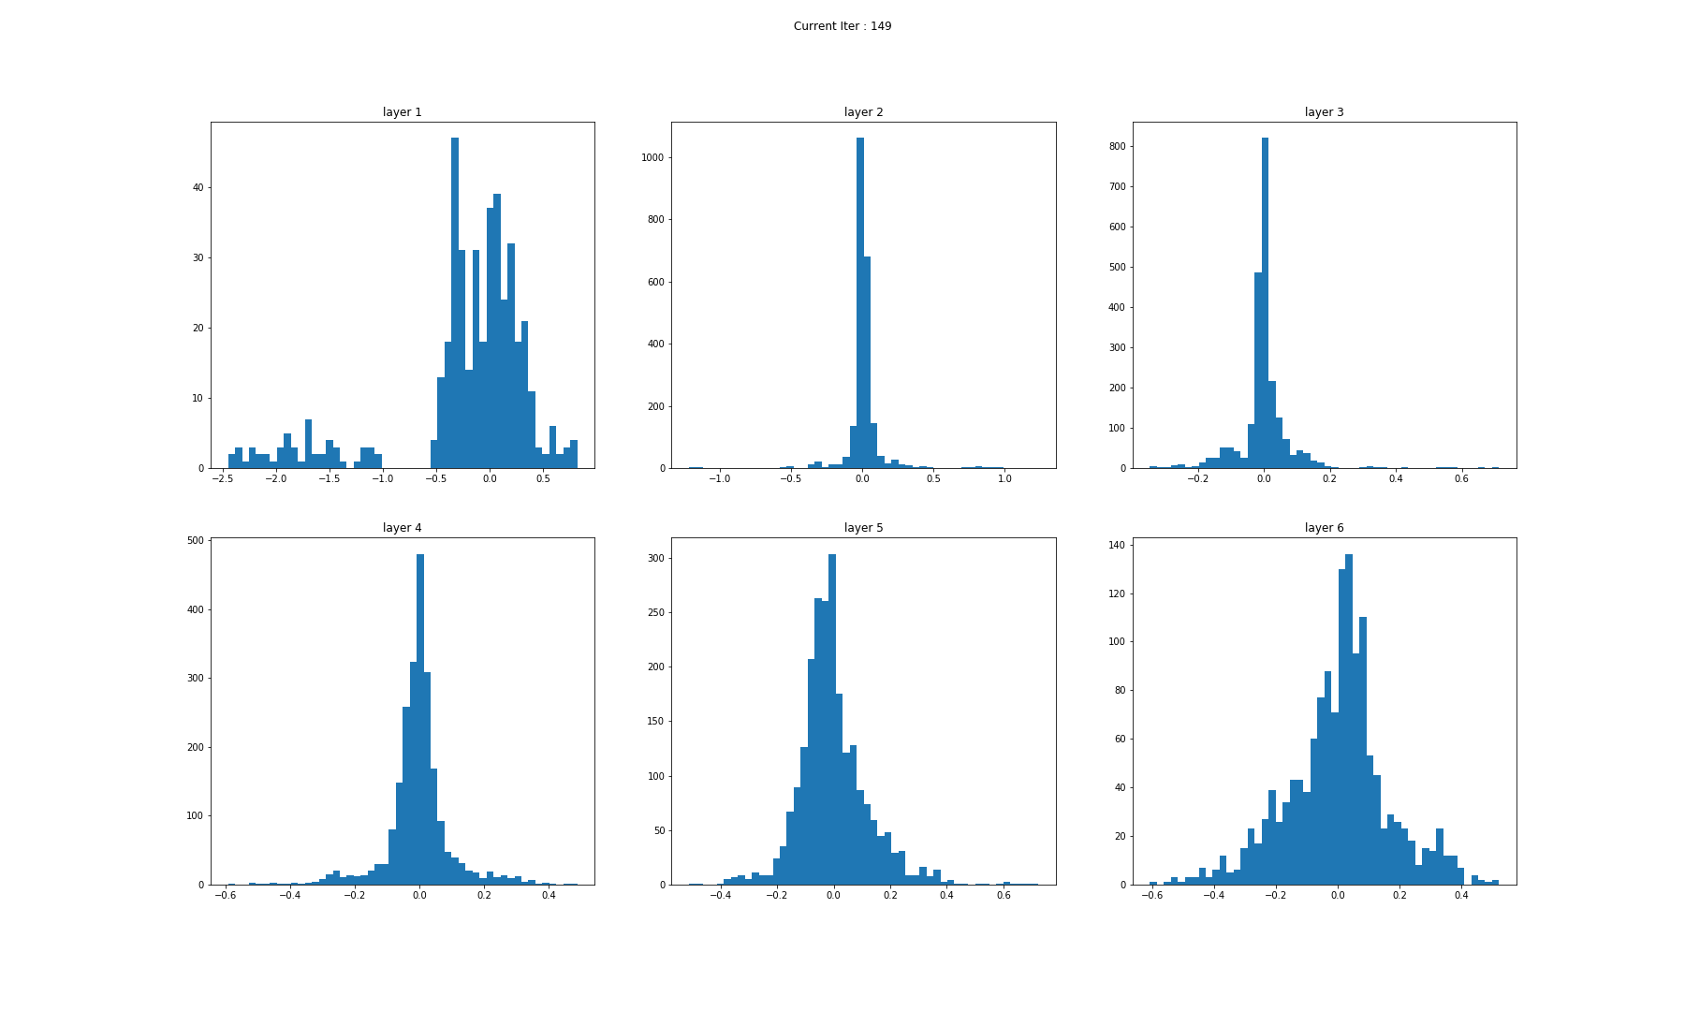
Gradients w.r.t. Weights at each layer (layer-1 to layer-6 Top left to bottom right)

Slide 15
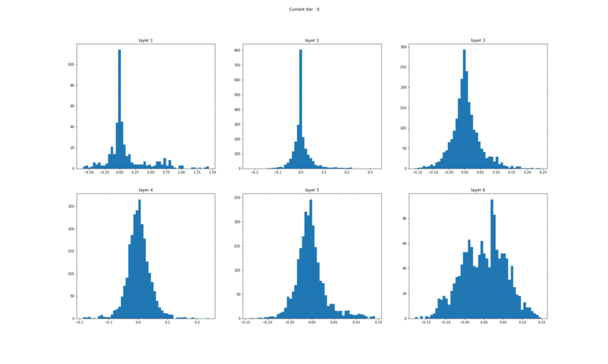
WITH BATCH NORM
Gradients w.r.t. Weights at each layer (layer-1 to layer-6 Top left to bottom right)

Slide 16
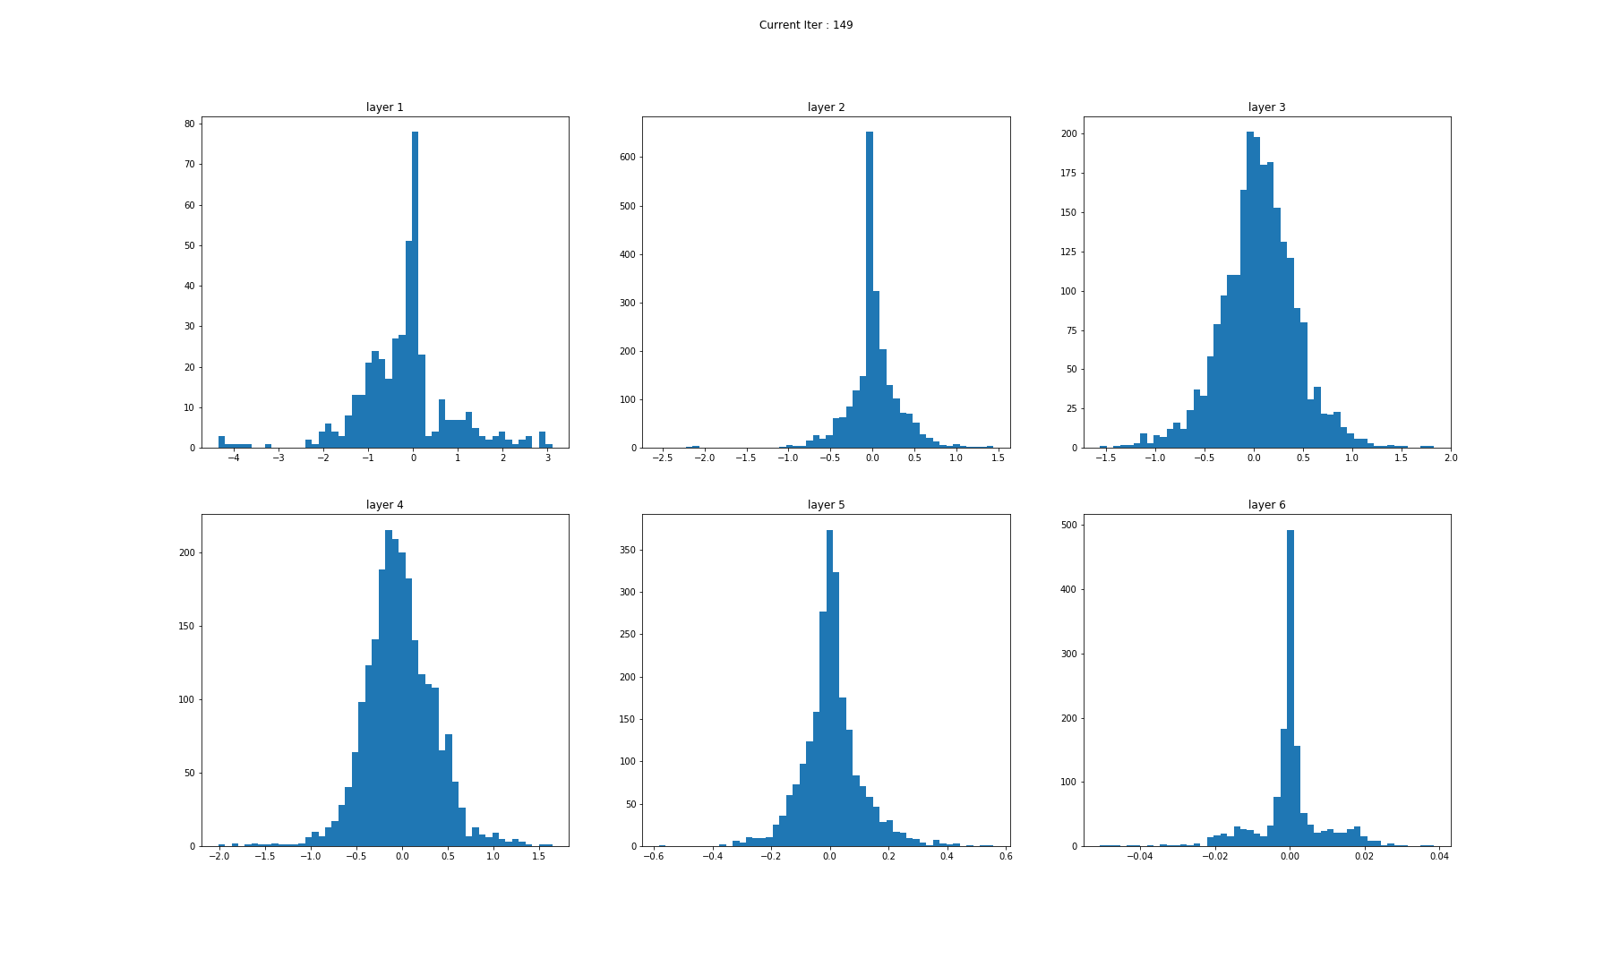

Slide 17
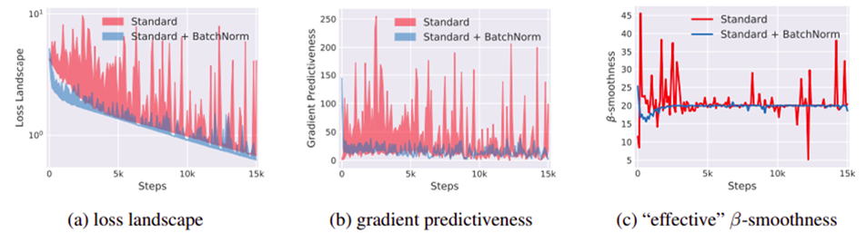
Effect of Batch Nomalization

Slide 18
Benefits of Batch Normalization
Inclusion of Batch Normalization technique in deep neural networks improves training time
BN enables the utilization of larger learning rates, this shortness the time of convergence when training neural networks
Reduces the common problem of vanishing gradients
Covariate shift within neural network is reduced

Slide 19
Overfitting and under-fitting
There are datasets for
Training
Validation and
Testing
All these dataset are mutually exclusive

Slide 20
Overfitting and under-fitting
Overfitting occurs when a statistical model or machine learning algorithm captures the noise of the data or the algorithm fits the data too well
Underfitting occurs when a statistical model or machine learning algorithm cannot capture the underlying trend of the data
Both overfitting and underfitting are not desirable in case of deep learning algorithms

Slide 21
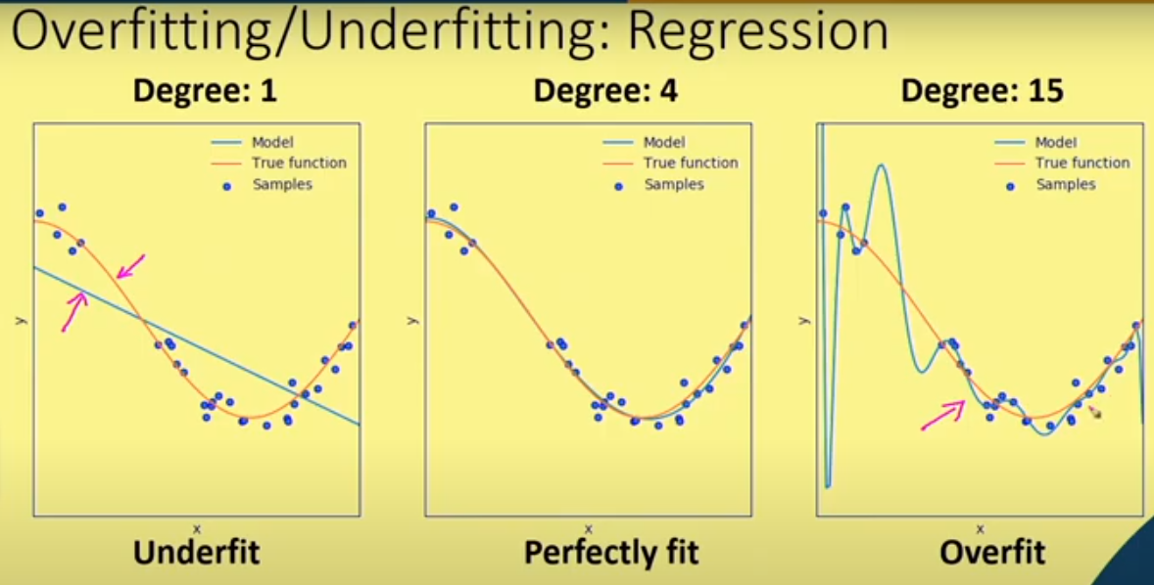
Overfitting and under-fitting
Regression Problem

Slide 22
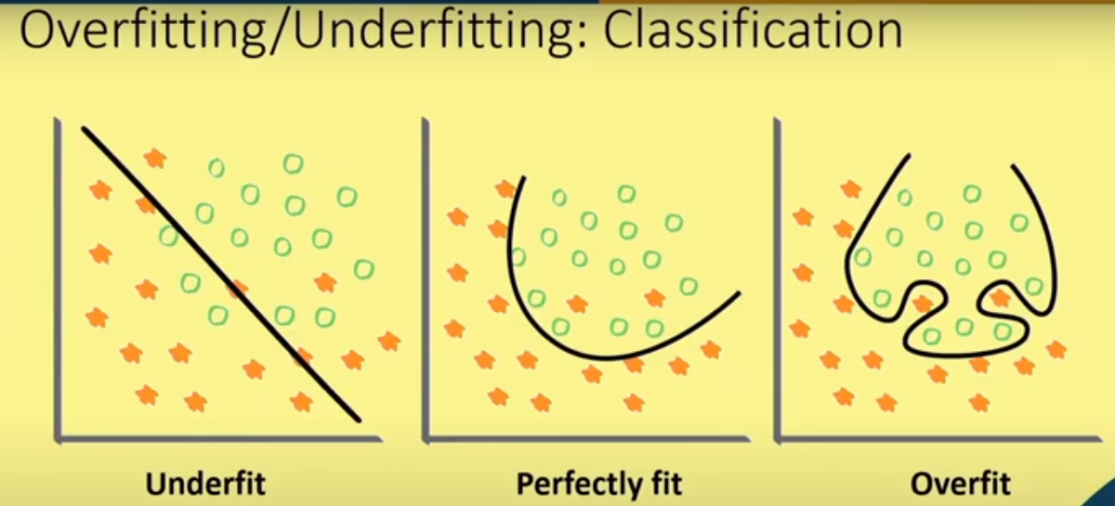
Overfitting and under-fitting
Classification problem

Slide 23
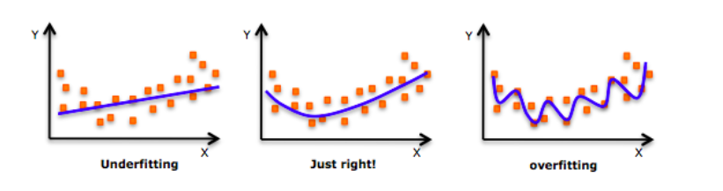
Overfitting and under-fitting
As we move towards the right in this image, our model tries to learn too well the details and the noise from the training data, which ultimately results in poor performance on the unseen data.

Slide 24
Regularization
What is Regularization?
How does Regularization help in reducing Overfitting?
Different Regularization techniques in Deep Learning
L1 and L2 regularization
Dropout
Early stopping
Data augmentation

Slide 25
Regularization
What is it?
Regularization is a technique which makes slight modifications to the learning algorithm such that the model generalizes better.
Why do we need it?
Improve generalization of our model on unseen data

Slide 26
Regularization
Regularization is a way to prevent overfitting
L1 and L2 are the most common types of regularization used in training deep models
General cost function with regularization for training is defined as: Cost function = Loss+ Regularization term
Due to this regularization term, the numerical values of weights decreases because it assumes that a neural network with smaller weights leads to simple models
So this helps to reduce overfitting

Slide 27
Regularization: L1 and L2
L1 regularizer: cost function= Loss + λ Σ|w|
It penalizes absolute value of weights
It can make some weights to zero. So useful for model compression
λ is a regularization hyper parameter. Controls the relative weight
L2 regularizer: Cost function= Loss +λ Σ ‖w‖
It penalizes second norm of weights
It is also termed as weight decay as it pushes the weights near to zero. But it does not make exactly zero always

Slide 28
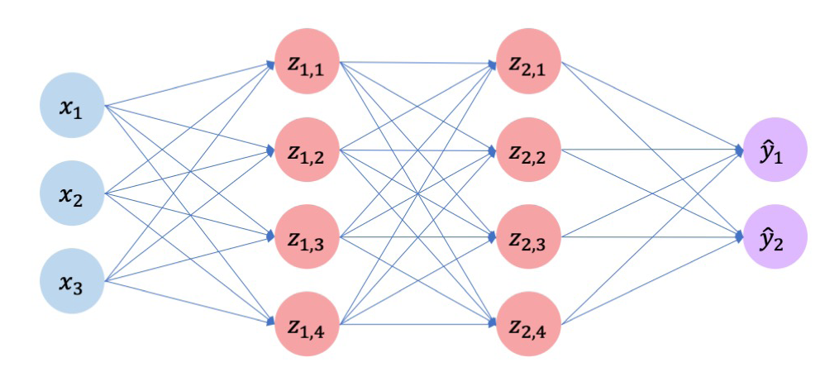
Regularization: Dropout
During training, randomly set some activation to 0

Slide 29
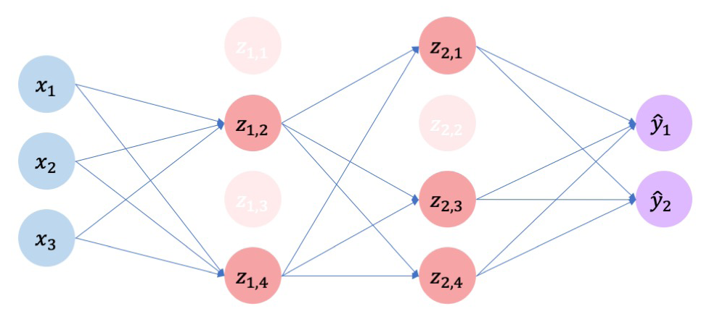
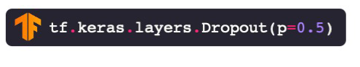
Regularization : Dropout
During training, randomly set some activation to 0
Typically ‘drop’ 50% of activations in layer
Forces network to not rely on any one node

Slide 30
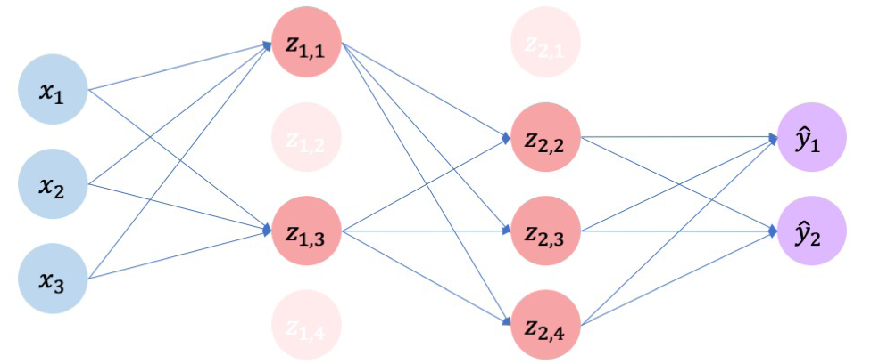
Regularization : Dropout
During training, randomly set some activation to 0
Typically ‘drop’ 50% of activations in layer
Forces network to not rely on any one node

Slide 31
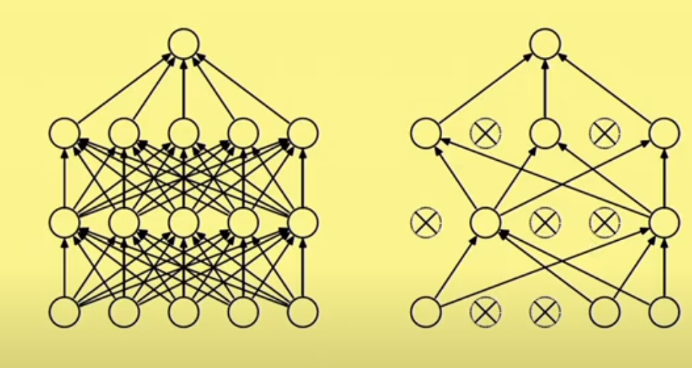
Regularization : Dropout

Slide 32
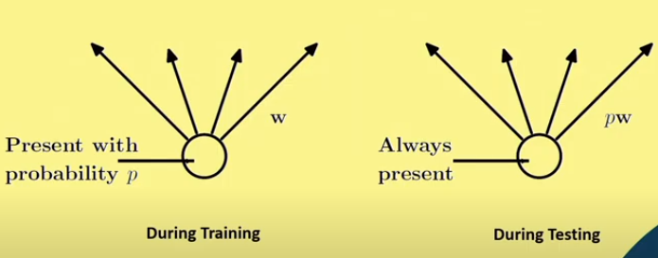
Regularization : Dropout

Slide 33
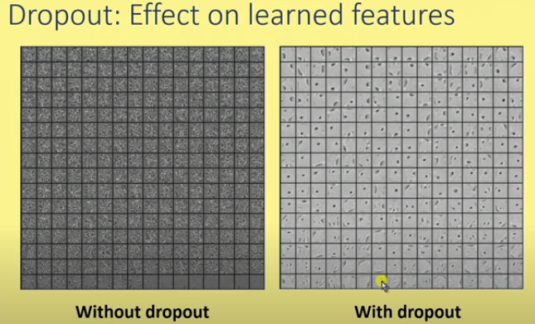
Regularization : Dropout
Features are learned by an auto encode on MNIST with a single hidden layer of 256 RLU with and without dropout

Slide 34
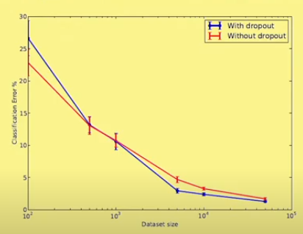
Regularization : Dropout
As the size of the data set is increased, the gain from dropout increases up to a point and then declines

Slide 35
Regularization : Early Stopping
Hyper parameters need to tuned for good performance while training neural networks
Number of epochs is a hyper parameter to be tuned.
Lesser epochs may lead to underfitting and more epoch may lead to overfitting
Early stopping attempts to remove the need of manually setting this value
So, it can also be considered a type of regularization method.

Slide 36
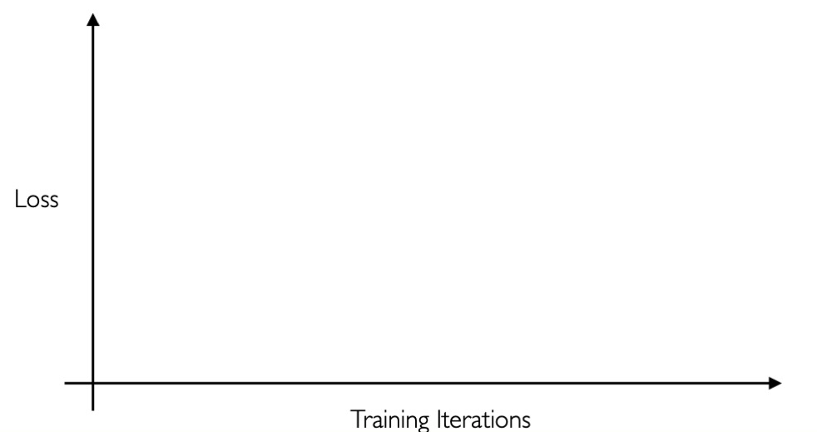
Regularization : Early Stopping
Stop training before we have a chance to overfit

Slide 37
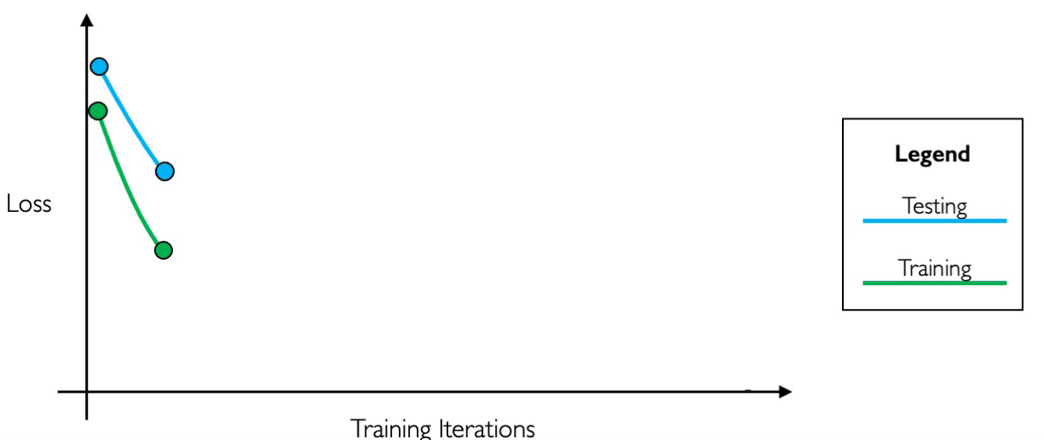
Regularization : Early Stopping
Stop training before we have a chance to overfit

Slide 38
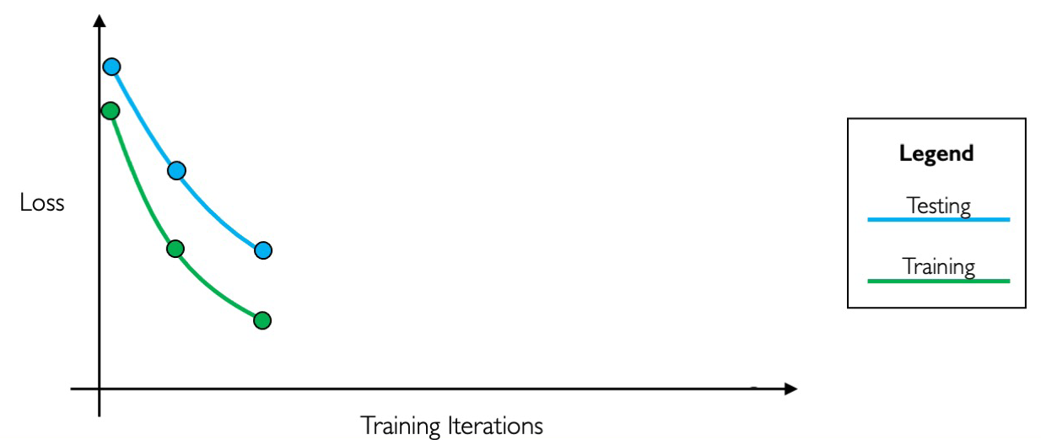
Regularization : Early Stopping
Stop training before we have a chance to overfit

Slide 39
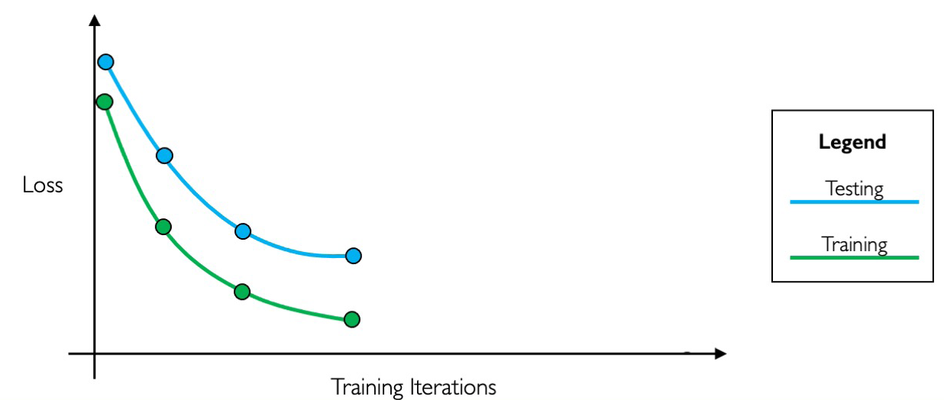
Regularization : Early Stopping
Stop training before we have a chance to overfit

Slide 40
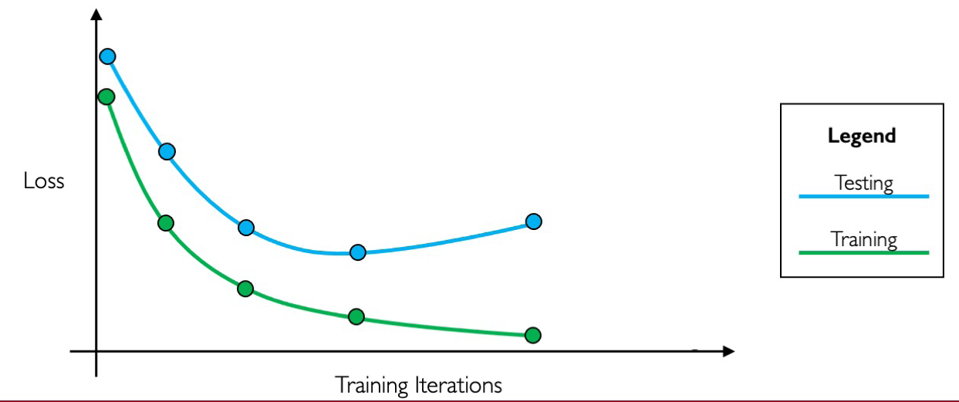
Regularization : Early Stopping
Stop training before we have a chance to overfit

Slide 41
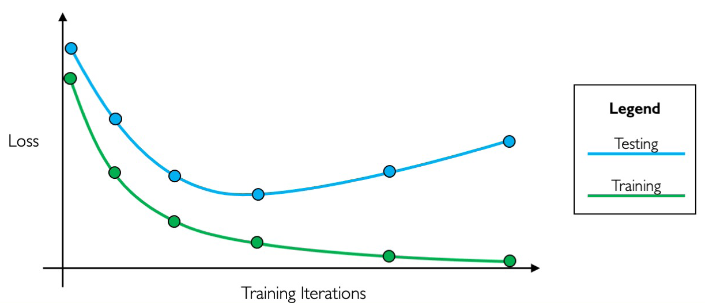
Regularization : Early Stopping
Stop training before we have a chance to overfit

Slide 42
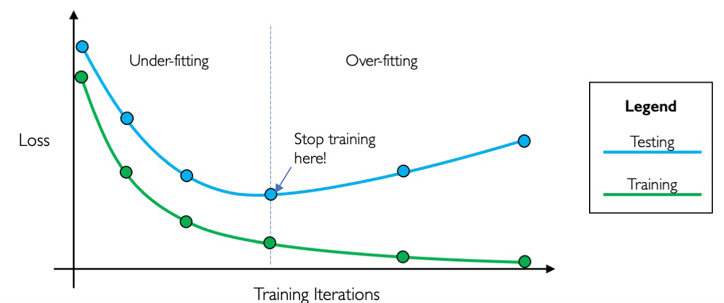
Regularization : Early Stopping

Slide 43
Regularization : Data Augmentation
Increasing the size of training data is a way to prevent overfitting
It is difficult and costly to increase the training data
Data augmentation is a way to create a different image from one image while keeping the context same
There are a few ways of augmenting training data- rotation, flipping, scaling , shifting, contrast, enhancement, brightness control, etc.

Slide 44
Source
https://www.analyticsvidhya.com/blog/2018/04/fundamentals-deep-learning-regularization-techniques/
L1 and L2 regularization
https://towardsdatascience.com/intuitions-on-l1-and-l2-regularisation-235f2db4c261

Slide 45
Thank you

Slide 46
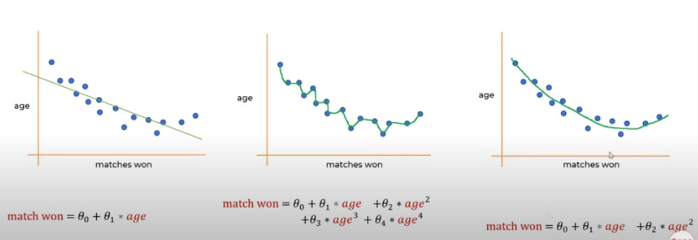
Regularization in ML (regression)

Slide 47
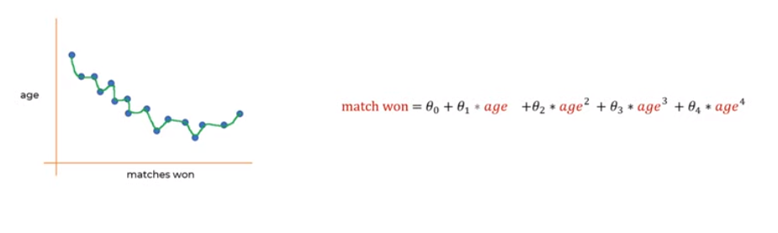
How to reduce the overfitting

Slide 48
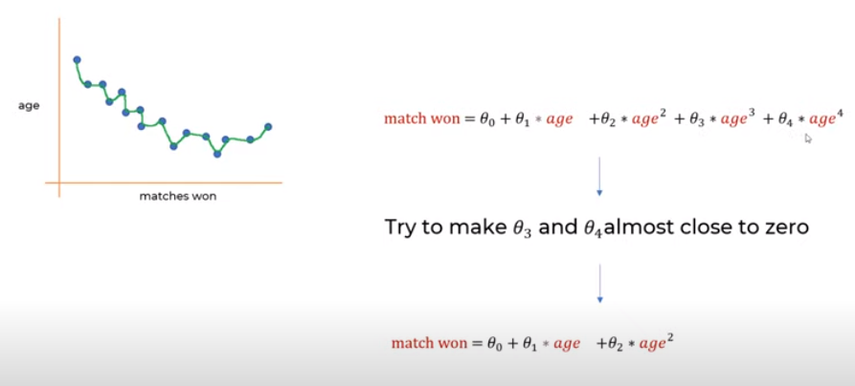

Slide 49
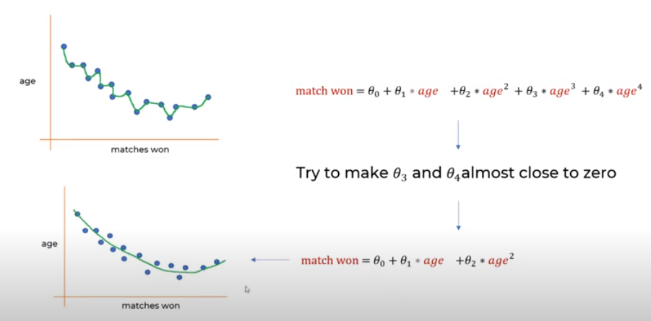

Slide 50
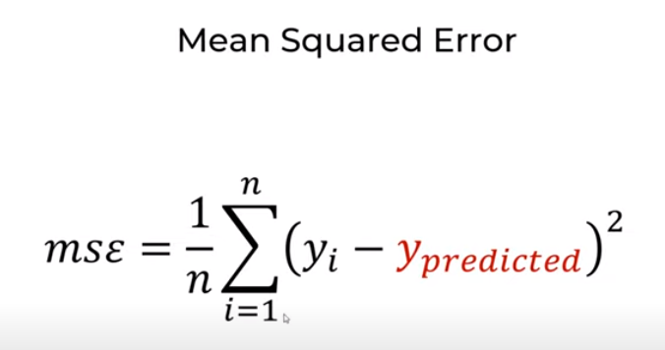
In regression

Slide 51
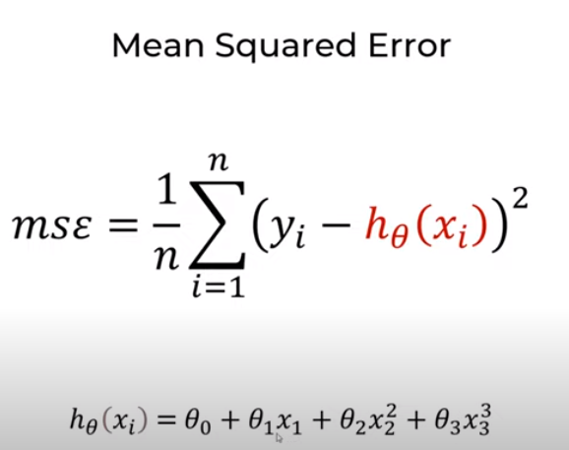

Slide 52
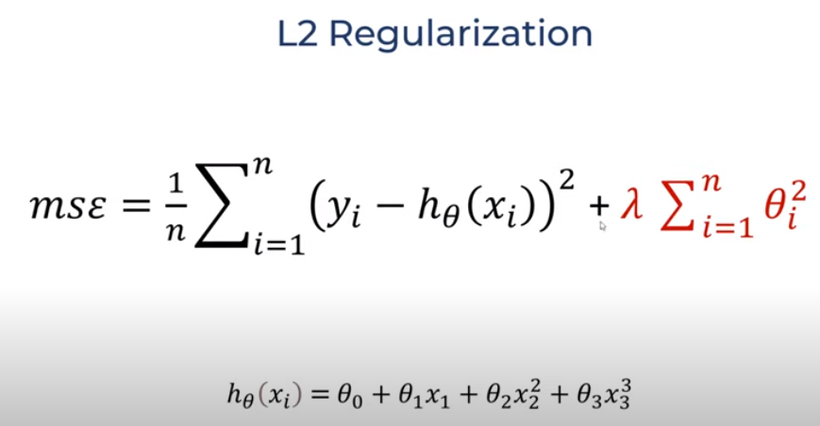

Slide 53
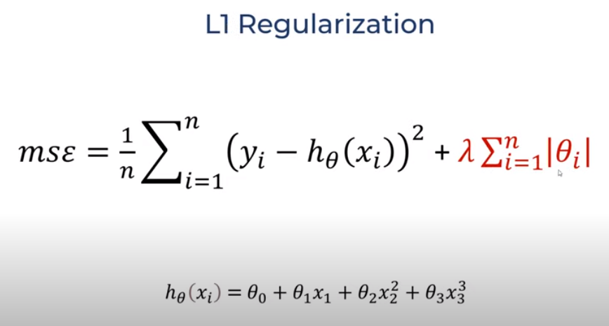

Slide 54
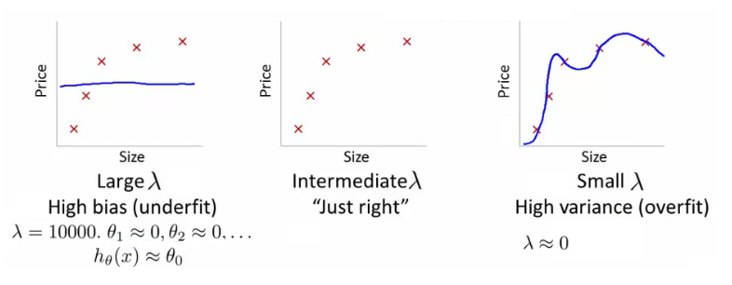

Slide 55
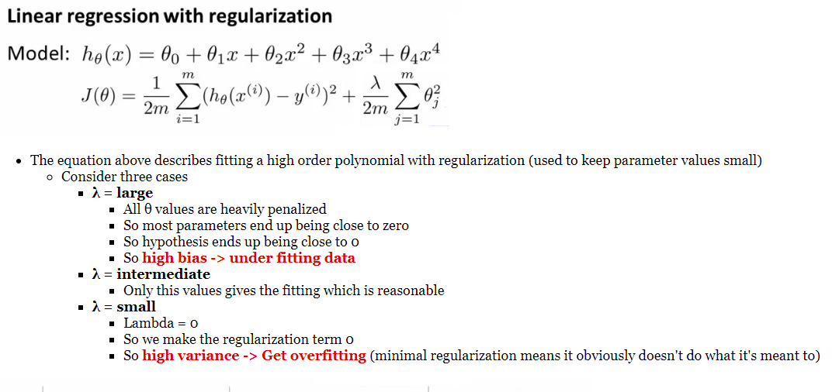

Slide 56
https://doc.plob.org/machine_learning/10_Advice_for_applying_machine_learning.html

